Slide 1
Visual Recognition
Week 1
Team 1
Eric López
Gerard Martí
Sergio Sancho
Adriana Fernández

Slide 2
Experiments
We made the experiments over the original code, adding whiten() before computing the dictionary and using cross-validation.
The testing procedure was:
Find the best number of samples for the bag of words.
Try different number of folds for the cross-validation.
Try HOG and LBP descriptors (computing the SIFT detector).
Try different SVM kernels with the best result obtained until now.
Try KNN instead of SVM.
We will evaluate the results by using confusion matrix, ROC curve and accuracy.

Slide 3
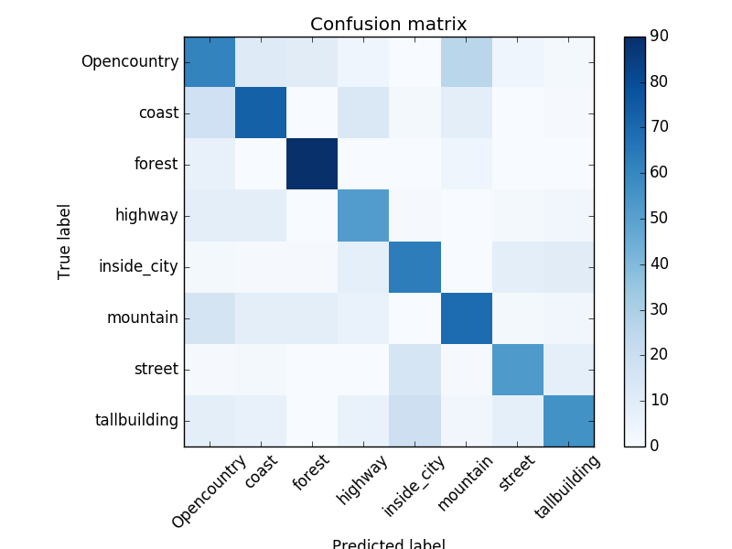
Results I
Number of samples: (Test with Linear SVM, SIFT)
Cross-validation (LinearSVM, SIFT, 50000 samples):
Confusion matrix for 50000 samples, and 5 fold cross-validation
Nº samples | 1000 | 5000 | 10000 | 20000 | 30000 | 40000 | 50000 | 60000 | 100000
Accuracy | 0.607 | 0.638 | 0.614 | 0.603 | 0.620 | 0.638 | 0.640 | 0.638 | 0.629
Nº folds | 2 | 4 | 6 | 8 | 10
Accuracy | 0.6307 | 0.613 | 0.638 | 0.624 | 0.636

Slide 4
Results II
In our experiments, we tried to describe the points detected by SIFT using LBP and HOG descriptors. To apply this descriptors, we decided to fix a window (16x16) centered on each keypoint.
To classify, our system implements SVM and KNN techniques. We decided to use KNN in order to look for the best descriptor because it was faster, assuming that the best descriptor will be the best for all classifiers.

Slide 5
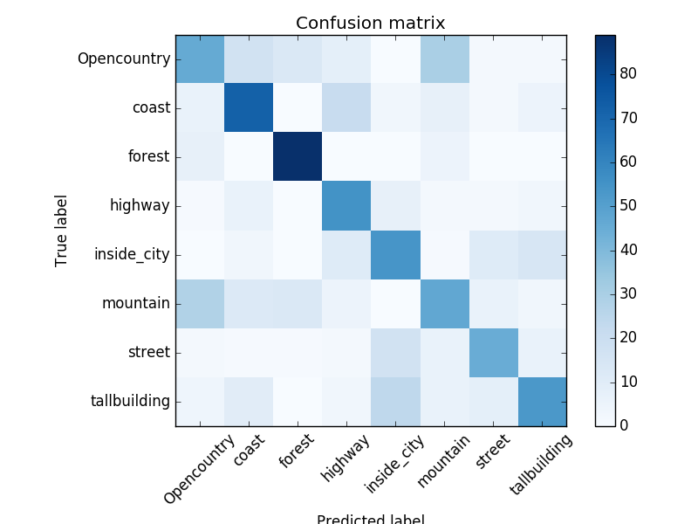
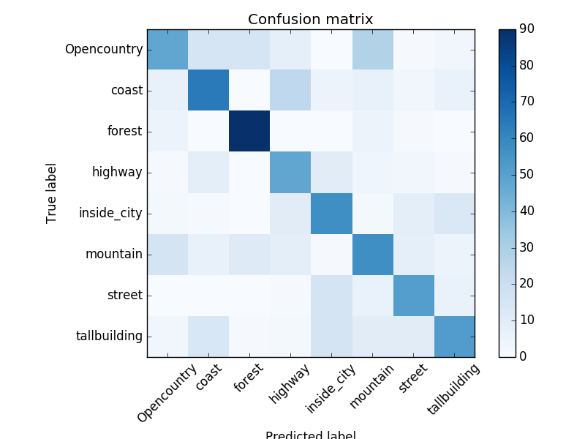
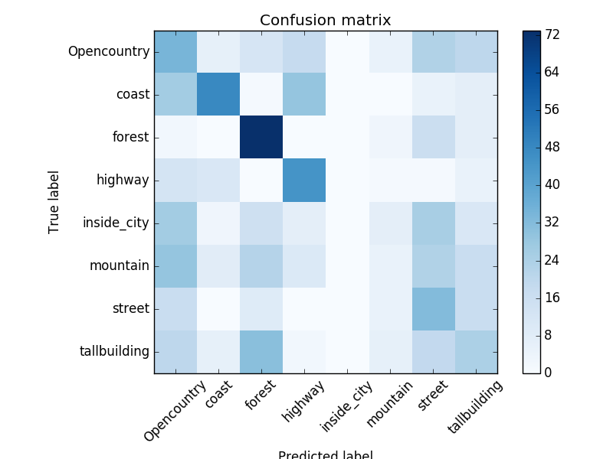
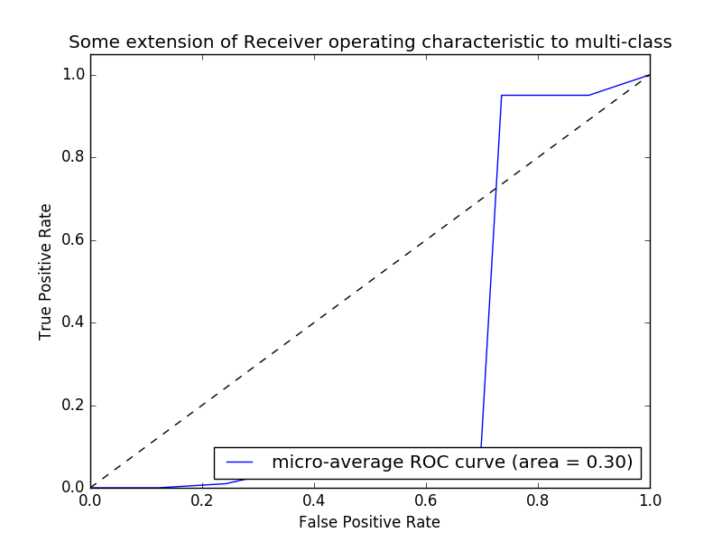
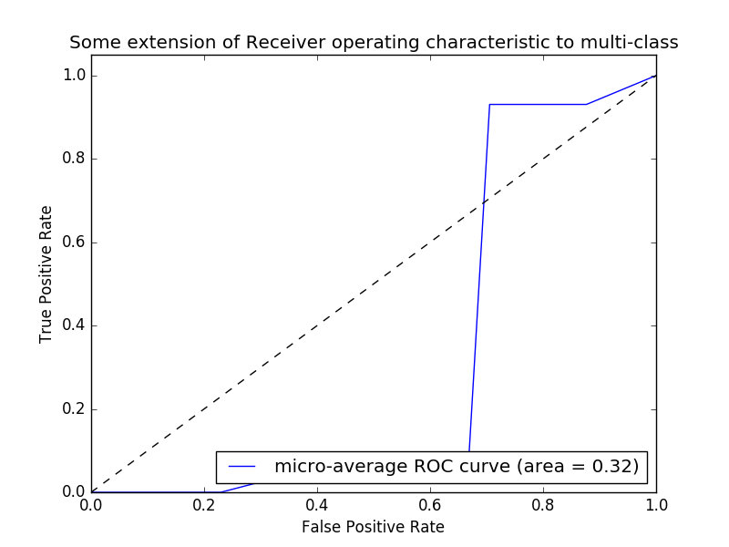
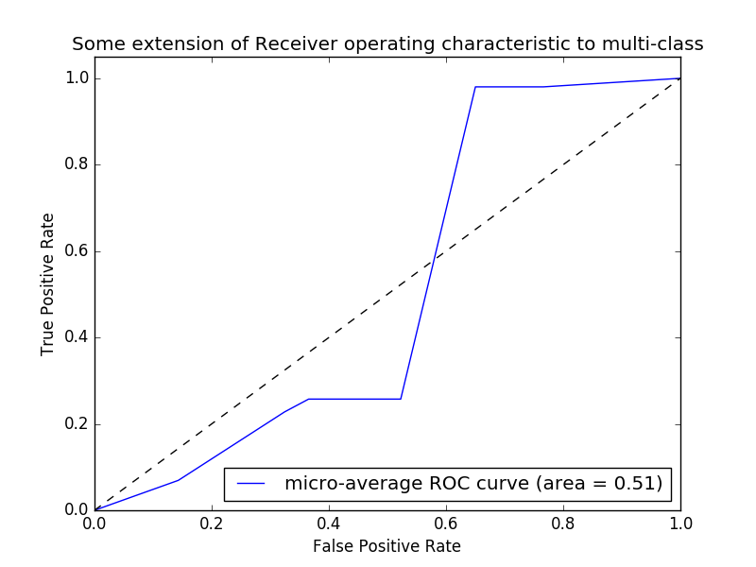
Results III
HOG (64x64 cell, 2x2 block)
RBF Kernel. Acc: 0.578
Linear Kernel. Acc: 0.5712
LBP (64x64 blocks)

Slide 6
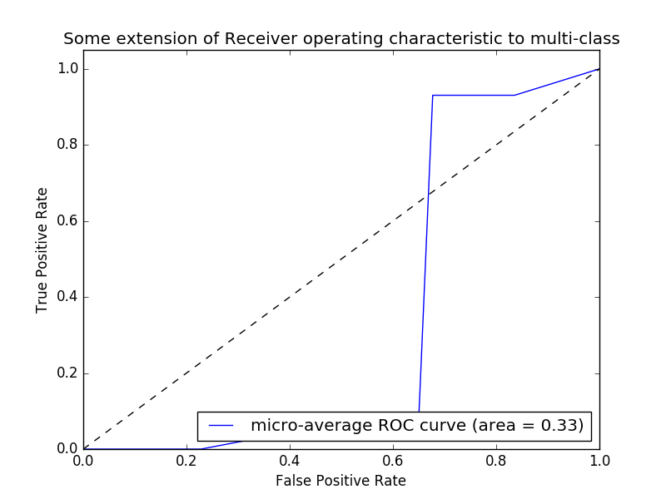
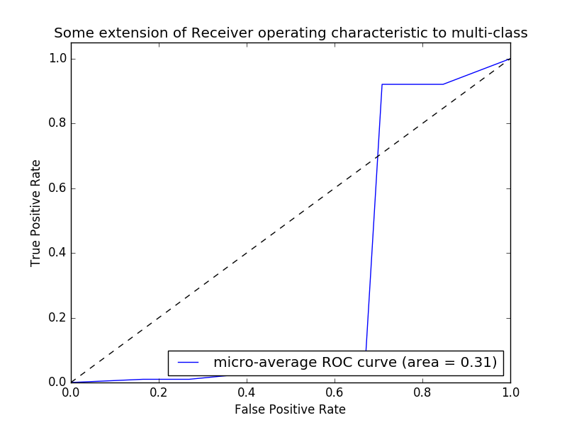
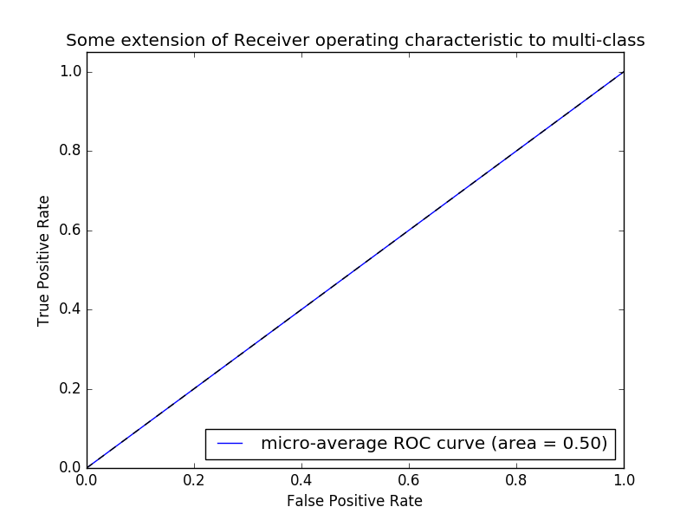

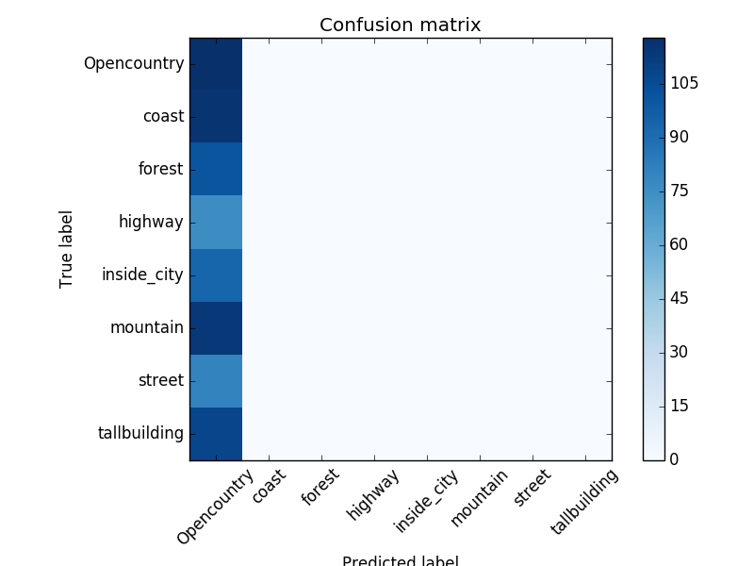
Results IV
Different Kernels for SVM (SIFT, 50000 samples):
Linear
RBF
Sigmoid
Acc: 0.64064
Acc: 0.5315
Acc: 0.1462

Slide 7
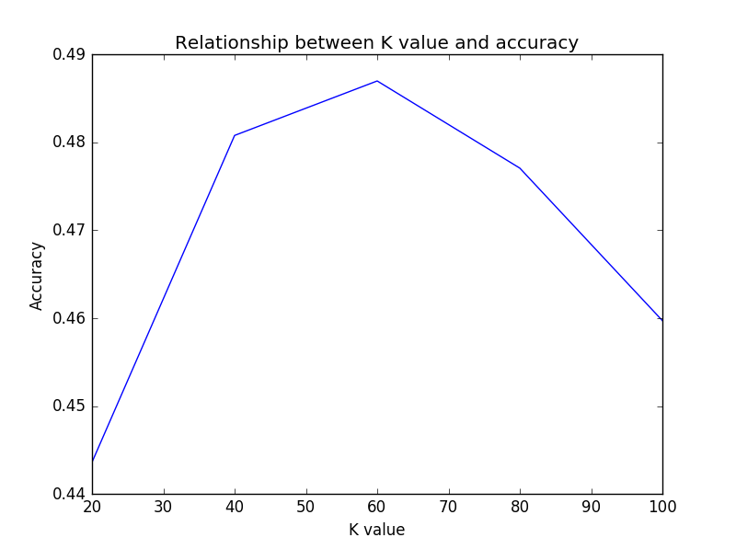
Results V
We performed an exhaustive search for the best parameter K of the KNN algorithm. We used SIFT descriptor and detector. As shown in the picture, the best accuracy was 0.485 obtained with K = 61.

Slide 8
Conclusions
A number of samples big enough provides us with the best results, but if the number of samples is too big it can hinder the performance.
Changing the number of folds in the cross validation does not seem to affect the performance of the system.
Linear Kernel provides better results for this problem than either RBF or sigmoid kernel, for the same parameters.
KNN classifier performance is worse than linear and RBF SVM.
SIFT descriptor is more accurate for this specific problem than LBP (which also has a lot higher computation time) and HOG.

